Slide 1

Texture Quality Analysis
CVI Club

Slide 2
Tasks Image segmentation Image Pre-processing Feature Recognition

Slide 3
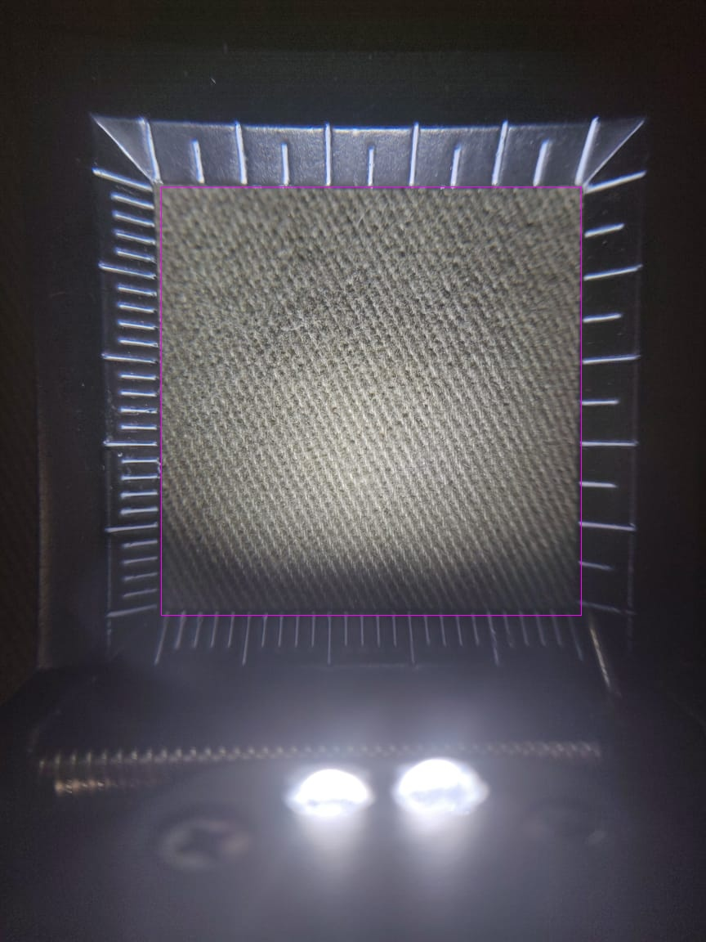
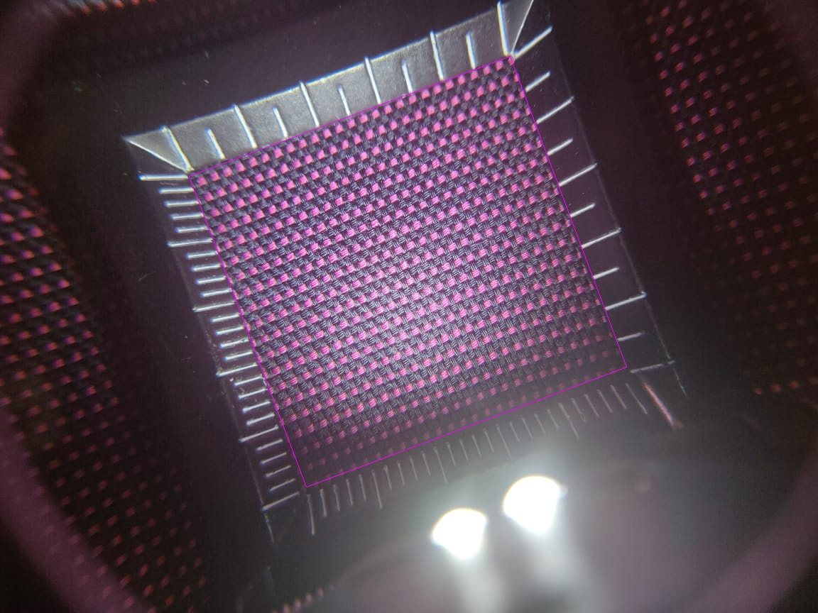
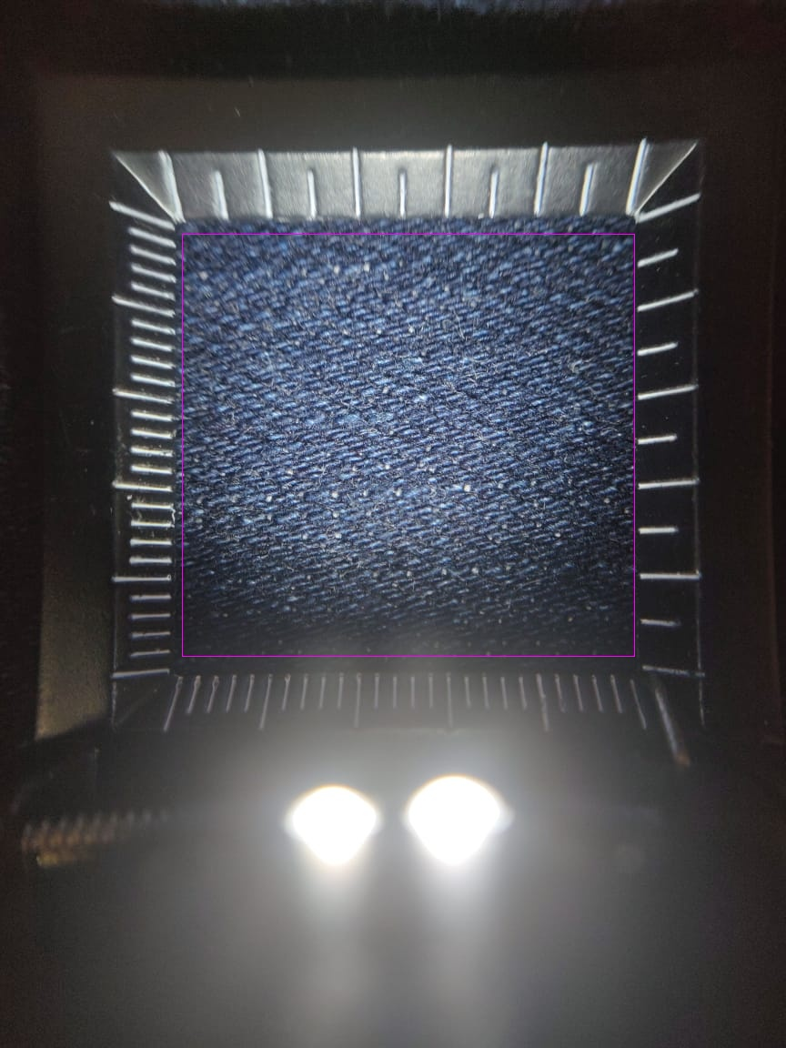
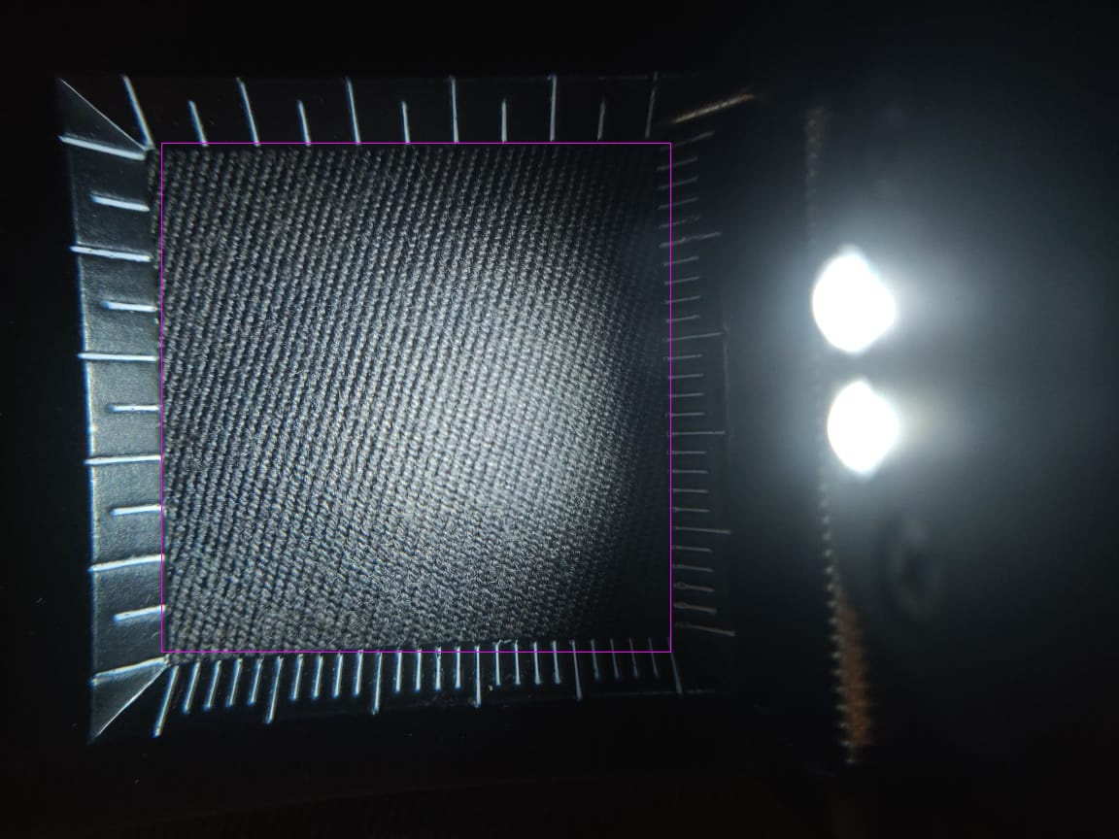
Image Segmentation
Goal: To crop the fabric from the magnified image.
We are developing algorithms to predict the bounding box enclosing the fabric inside the pick glass.
Algorithms: Adaptive Thresholding and Contour detection

Slide 4
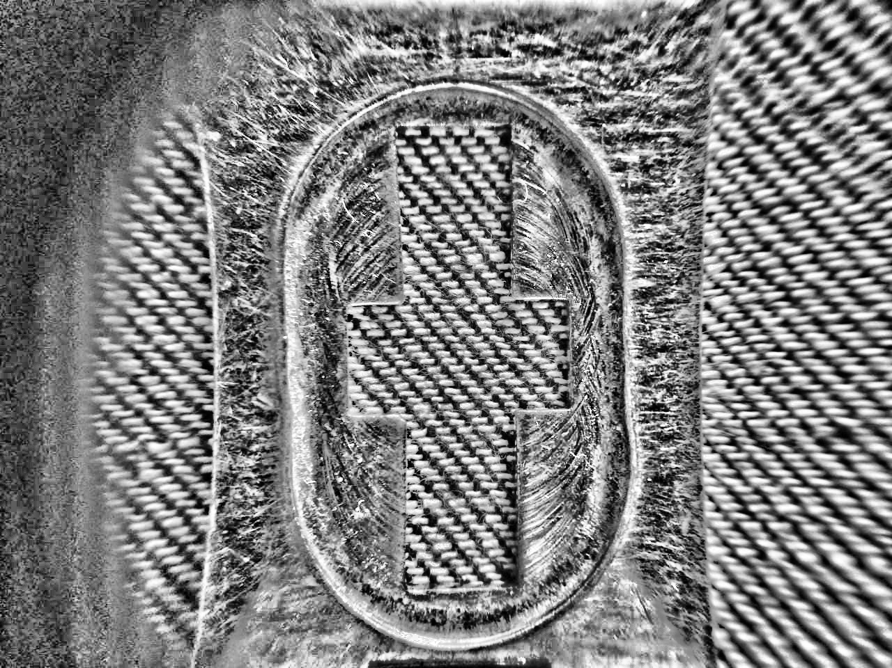
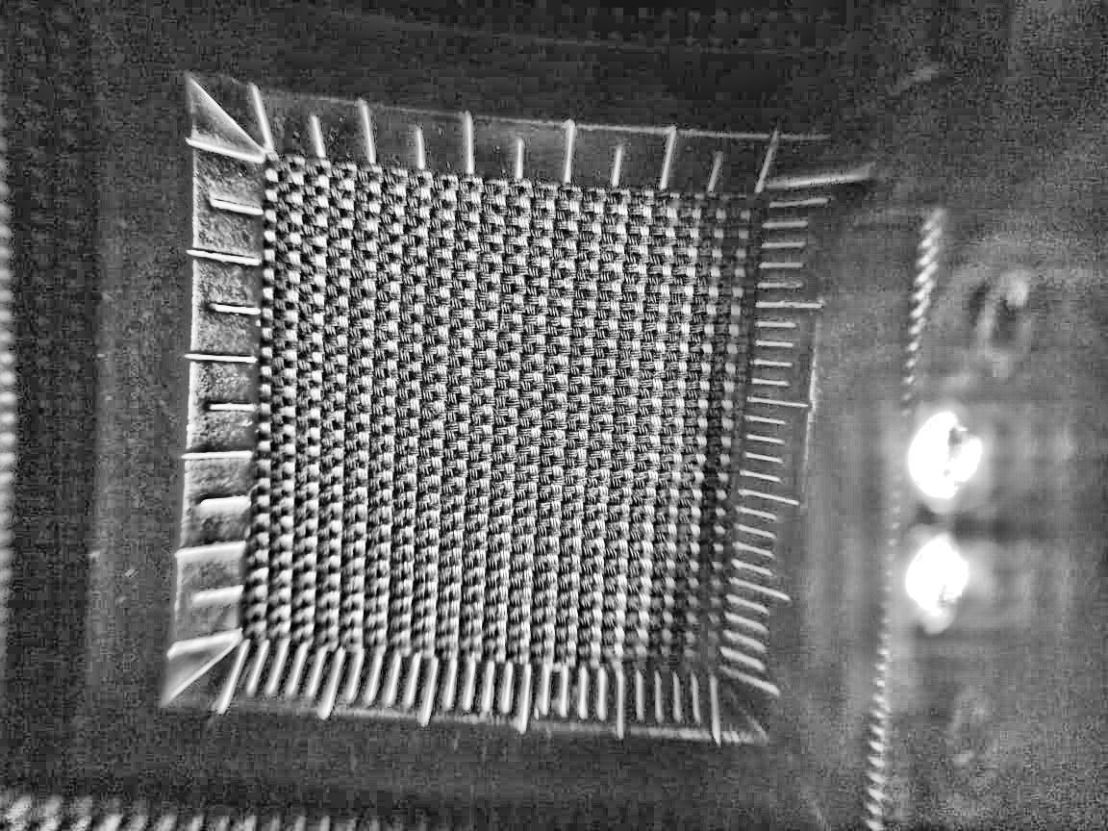
Image Pre-processing
Goal: To pre-process the image. This involves removing noise, bad lighting and blurriness in the image.
Algorithms: Histogram equalization and CLAHE.

Slide 5
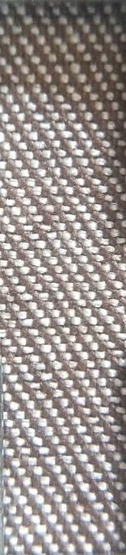

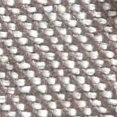


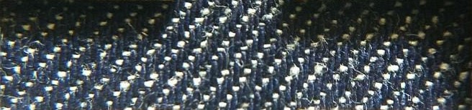
Feature Recognition
Goal: To calculate the warp density in the pre-processed image.
Algorithms: Hough transform, connected components and template matching.

